Slide 1

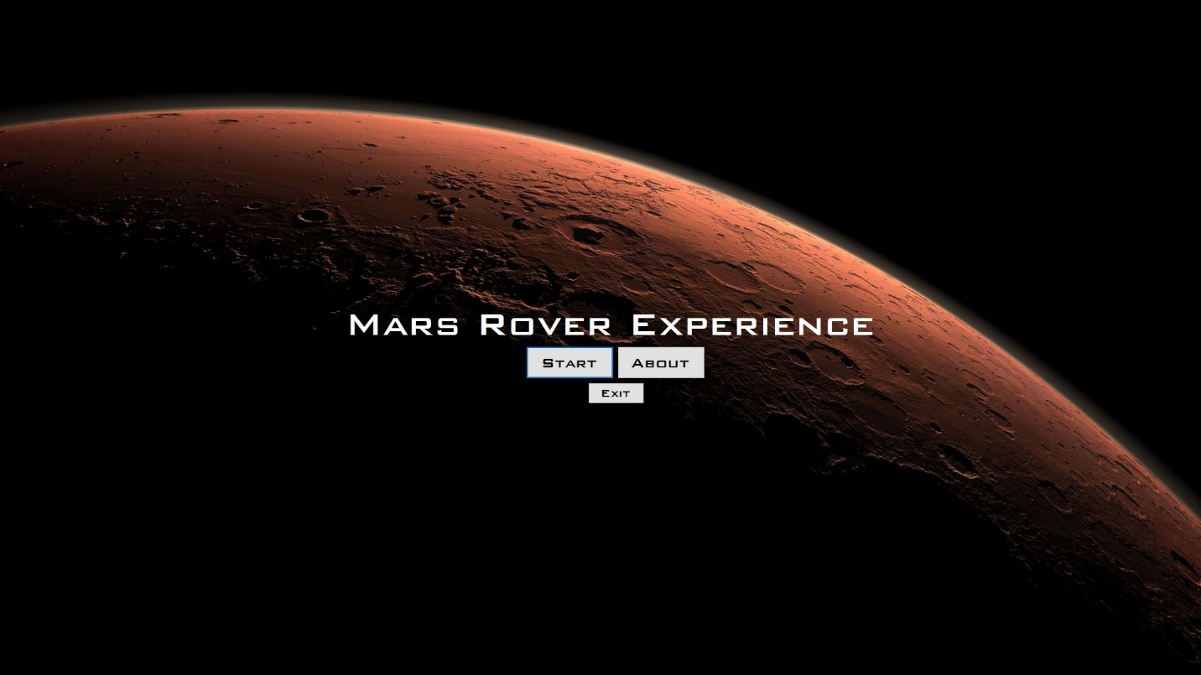
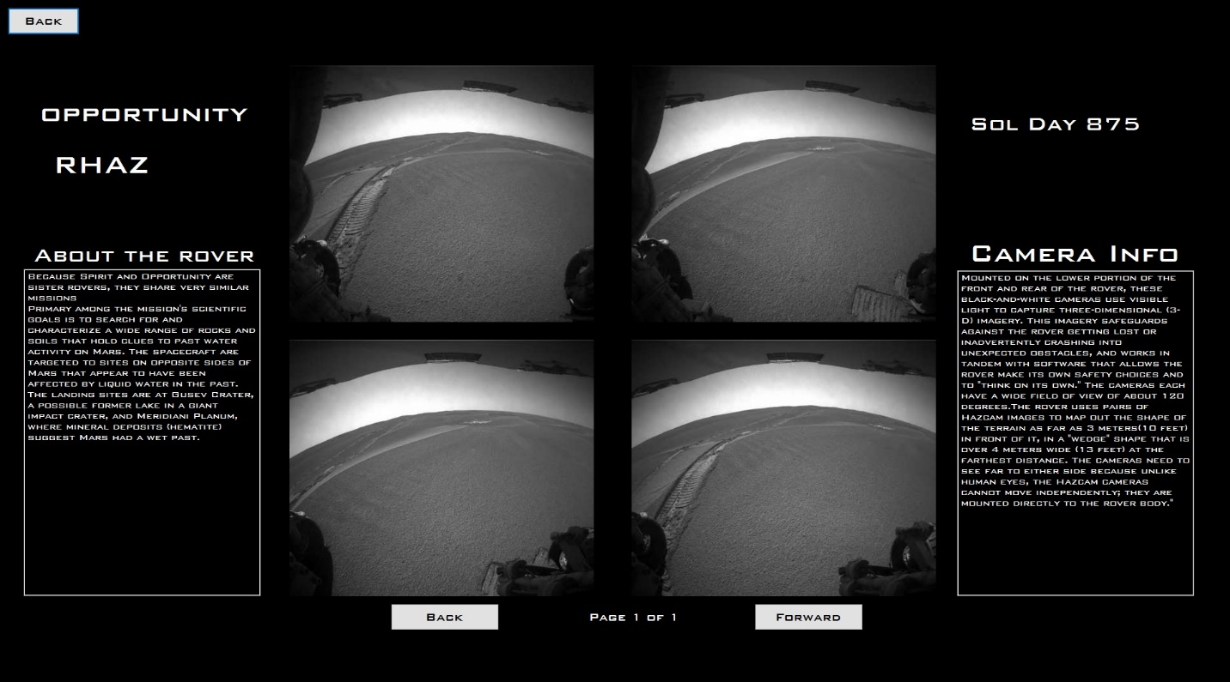
The Dogs – Mars Rover Experience
Jordan Johnson (SR SWEN) and Sadi Hulgan (SR INSY)
Utilized C# and Visual Studio to create an intuitive, aesthetically pleasing user interface
Focused on creating an experience instead of just an application

